Slide 1
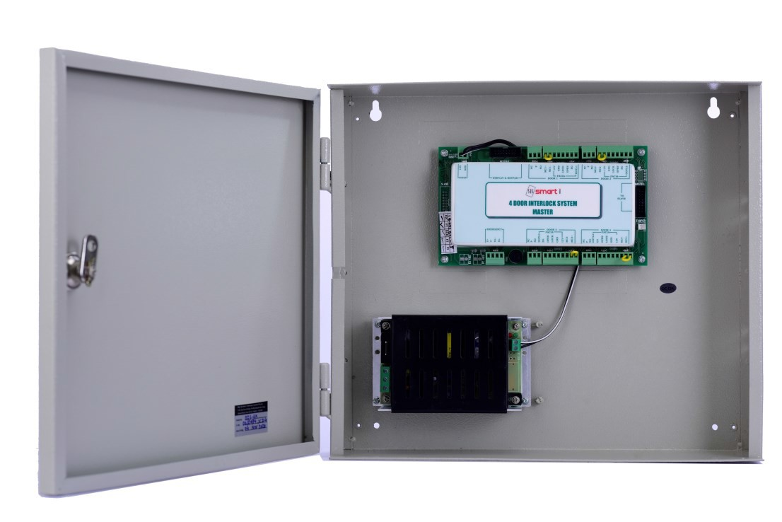
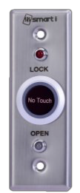
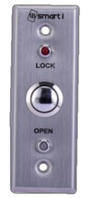
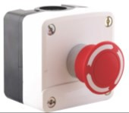
Datasheet
Door Interlocking Solutions
enviroDIS
Door Interlocking System with Accessories
smartDIS is an perfect Door Interlocking System – DIS-2X, DIS-4X, DIS-4SV for its clients which operate in meticulous environment where preventing air contamination is of paramount importance. With top-of-the range interlock technology it offers best solutions for Pharma Industries, Laboratories, Clean Room, Operation Theatres & Critical Electronic Components manufactures like Semiconductors & microchips.
Key Features & Benefits
Superior user configurable interlock logic without use of PC / Computer
Action based field events as per user requirement e.g. Centralized emergency switch, Emergency Switch at every door
Controls Up to 8 Doors using slave ID
Attractive LED indications & Fascia plates
RS485 Modbus Communication protocol provides Flexibility to integrate with multiple types third party environments i.e. BMS
Din rail mounting
V1.0_18072024

Slide 2


Datasheet
enviroDIS
Technical Specifications
DIS Panel
Particulars | smartDIS
Model Number | DIS-2X | DIS-4X | DIS-4SV
Door Release Outputs | 2 o/p (Lock) | 4 o/p (Lock) | 4 o/p (Lock)
Alarm Output | 1 Buzzer o/p for Alarms | 1 Buzzer o/p for Alarms | 1 Buzzer o/p for Alarms
Control Inputs | 2 nos. (Egress, Magnetic contact) | 4 nos. (Egress, Magnetic contact) | 4 nos. (Egress, Magnetic contact)
Communication Protocol | Modbus RS485 | Modbus RS485 | Modbus RS485
Emergency Operation Inputs | Fire | Fire | Fire
Maximum Door Controller | 2 | 4 | 4
Expandable | Not Expandable | Upto 8 Door (Using Slave Controller) | NA
Relay Contact Output | 0.5 amp for 230 V AC/1.0 amp for 12 V DC | 0.5 amp for 230 V AC/1.0 amp for 12 V DC | 0.5 amp for 230 V AC/1.0 amp for 12 V DC
Supply Voltage | 12 V DC | 12 V DC | 12 V DC
Current (Amps) | 2 Amps | 2 Amps | 2 Amps
Dimension in mm (L x W x H) | 390 x 90 x 320 | 390 x 90 x 320 | 390 x 90 x 320
Fascia Plates
Particulars | DIS fascia | DIS fascia - NT | DIS es
Model Number | DIS-FP3 (Facia Plate) | DIS-FP-IR4 | DIS-ES2
Type | Contact/Push | Contactless | Contact/Push
LED indication | Door Open LED (Green) | Door Open LED (Green) | NA
 | Door Open LED (Red) | Door Open LED (Red) | NA
Facia Plate Dimension | 40(L) x 20(W)x 115(H) mm | 40(L) x 25(W)x 115(H) mm | 40(L) x 25(W)x 115(H) mm
Wall Cut out | 32(L) x 20(W)x105(H)mm | 32(L)x25x(W)x105(H)mm | 32(L)x25x(W)x105(H)mm
Alarm Output | 1 Buzzer o/p for alarms | 1 Buzzer o/p for alarms | NA
Input | Door open switch or Egress switch | Door open switch or Egress switch | Door open or Emergency Egress switch
Note: Product images are for illustrative purpose only and may differ from the actual product. All Specs are subject to change without notice due to continuous improvements
ENVIRO TECHNOLOGIES
D-7/Unit No 254, Bhumi World Industrial Park, Pimplas, Bhiwandi, Thane, Maharashtra - 421302. INDIA
Boardline - +91-8767-247-247 | Email: presales@enviroworld.in Web: www.enviro-technologies.com

