Slide 1
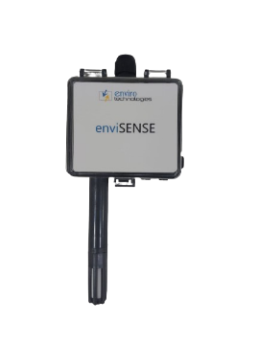
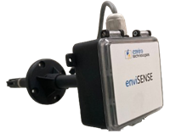
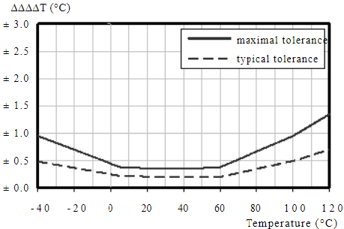
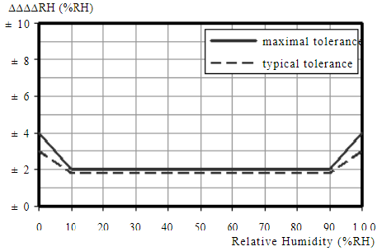
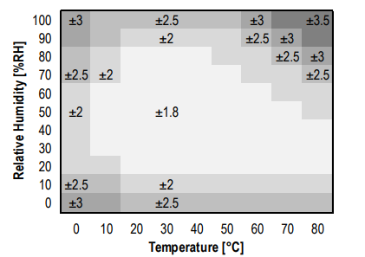
EnviSense Temp. + Humidity Sensor
enviSENSE Series
Sensor Element
Accurate Measurement
Wall/Duct Mount Temp + Humidity Sensors
Digital Sensor with capacitive sensor technology for Rh & band gap sensor technology, Factory Calibrated.
High Performance digital sensors allows accurate measurement & fast Response of 10ms
Weather Proof
IP65 Cabinet & IP54 Sensor Nozzle
Stability
Long Term Stability for T+RH sensor
Easy to Install
enviSENSE series devices are high performance, “all-in-one” temperature and Humidity transmitter. Its high reliability industrial design and offers 4-20 mA output signal transmission. It is wired loop transmitter (Two wire transmitter) It accurately measures humidity using capacitive sensor technology & temperature using band gap sensor technology. Wall mount, duct mount versions available.
Accuracy Chart
Technical Specification
Input Power | 24vDC (18vDC to 30vDC)
Analog Output | 4 to 20 mA, 0 to 10 V (Factory Default)
Operating Temperature Range | -30°C to 70°C (-20 to 158 °F) without display Model
Operating Humidity Range | 0 to 95% RH non-condensing
Housing Material | ABS plastic
IP Rating | IP 65 for Cabinet, IP54 for Sensor Nozzle
RH TRANSMITTER
Sensor Type | Capacitive Humidity sensor (Digital)
Accuracy | Option1: ±2% RH (For range of 10-90%RH) Option1: ±3% RH (For range of 20-80%RH)
Hysteresis | 1.5% typical
Stability | <+/-1% @ 20°C (68 °F) annually
Output Range | 0 to 100% RH
Resolution | 0.1% RH
TEMPERATURE TRANSMITTER
WARRANTY
Sensor Type | Band Gap Temperature (Digital)
Accuracy | Option1: ±0.2°C (For the range of 0°C to 60°C) Option1: ±0.3°C (For the range of 0°C to 40°C)
Resolution | 0.1°C (0.1°F)
Range | 0 to 70°C (32 to 158°F)
Limited Warranty
1 year
COMPLIANCE INFORMATION
Agency Approval | CE Compliance Design
WIRING TERMINALS
Field Calibration | Available (Need to use external probe and Calibration Software Utility)
Terminal Blocks | Screw terminals, 18-24 AWG
Version: V1.3_17112023

Slide 2
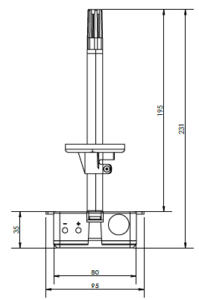
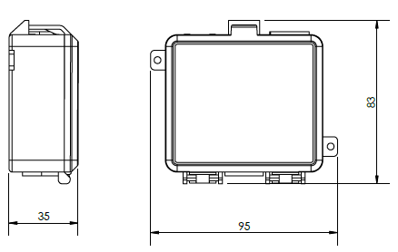
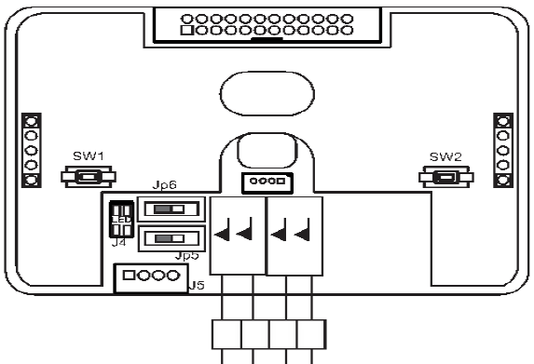


EnviSense Temp. + Humidity Sensor
Dimensional Drawing
Temp + RH Transmitter Wall & Duct Mount (No Display)
Wiring Diagram
CH-2
24V
CH-1
GND
24V
Temp
GND
Humidity
Ordering Information
Sensor Type
Display Type
Output
Accuracy
Mounting
Enclosure
Example:
ETT
1
2
3
4
5
6
1
2
3
4
5
6
K01 = Temperature
K02 + RH
K03 = Temp + RH
0 = No Display
2 = LCD TFT Display
1 = 4 - 20 mA
2 = 0 - 10 V
3 = RS485 MODBUS
ETT
K03
0
1
2
1
1
1 = Temp: ± 0.3 Degree; ± 3% RH
2 =Temp: ± 0.2 Degree; ± 2% RH
1 = Wall Mount
2 = Duct Mount
1 = ABS
2 = Flameproof
3 =Front SS Plate with Back MS Box
Model No : ETT-K03-012-11
Description : enviSENSE - Sensor type: Temperature + Humidity, Display Type: No Display, Output: 4 - 20 mA, Accuracy: Temp: ± 0.2 Degree ; ± 2% RH, Mounting: Wall Mount, Enclosure: ABS
Note: Product images are for illustrative purpose only and may differ from the actual product. All Specs are subject to change without notice due to continuous improvements
ENVIRO TECHNOLOGIES
D-7/Unit No 254, Bhumi World Industrial Park, Pimplas, Bhiwandi, Thane, Maharashtra - 421302. INDIA
Boardline - +91-8767-247-247 | Email: presales@enviroworld.in Web: www.enviro-technologies.com

